Slide 1

Intro to ASP.NET MVC

Slide 2
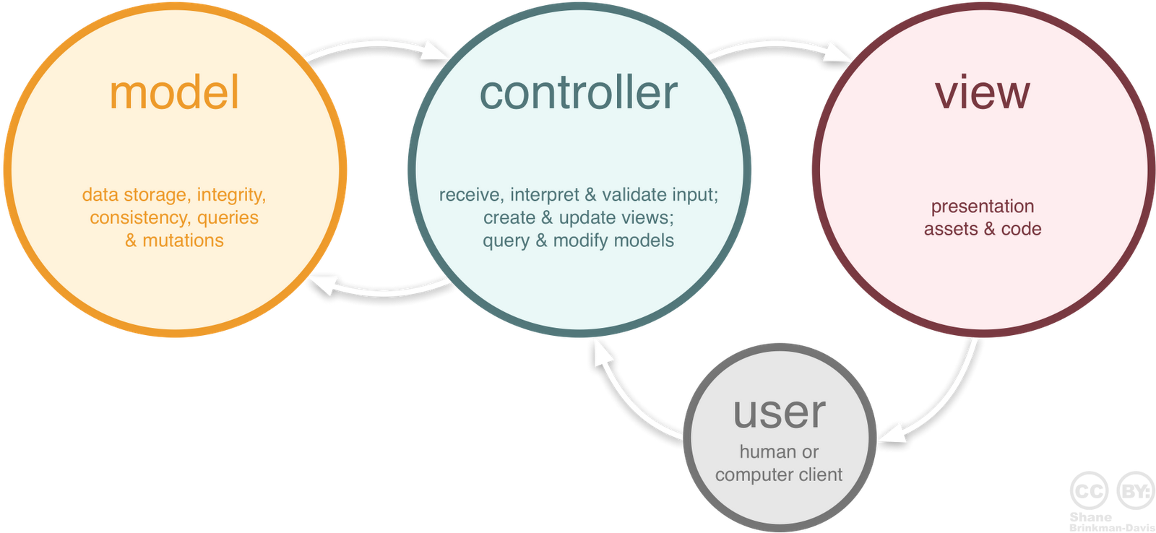
MVC
Model – A representation of the database
View – Visual output that the user interacts with
Controller – Handles input from the user, updates views, queries and modifies the model

Slide 3
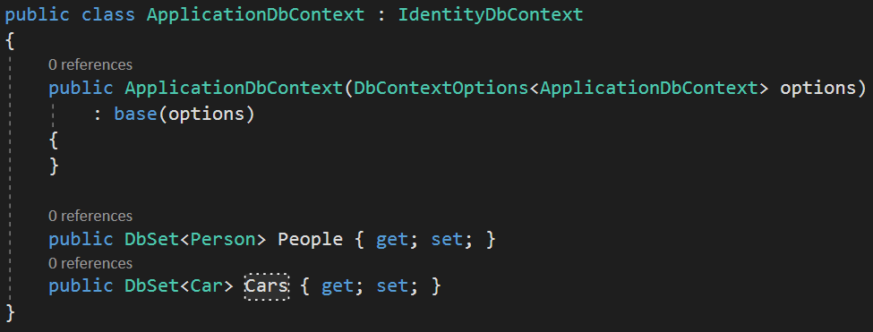
Model w/ Entity Framework
ApplicationDbContext is a representation of our database as a whole
DbSet<Person> Person and DbSet<Car> each represents a table in the database
These are located in the ApplicationDbContext.cs

Slide 4
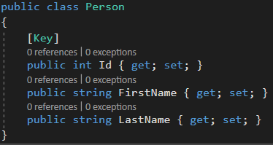
Model w/ Entity Framework
This is an individual model
This class represents a row in the database
The properties(Id, FirstName, LastName) represent columns

Slide 5
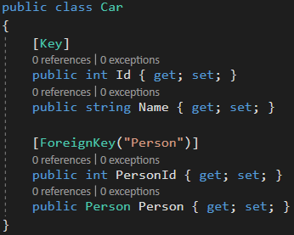
Model w/ Entity Framework
This is an individual model with a foreign key
The properties(Id, Name, PersonId) represent columns
The ForeignKey attributes states that there is a foreign key relationship between the Car model and Person model
Notes:
Draw out Car table to show that there isn't actually a 'Person' column.
Foreign keys will be covered more indepth two days from now – they are not needed for the Superheroes project.

Slide 6
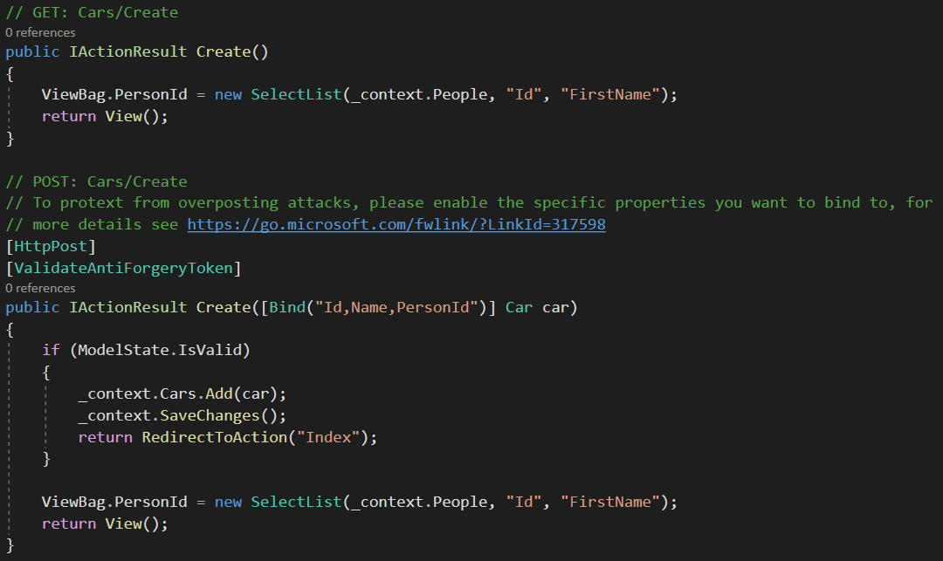
Controller
Controller handles most of the logic
Queries the database and send info to view
Often has GET and POST methods for each view
Bind attribute prevents hackers from over-posting data to the model.
Include tells model binder to only populate properties with names specified
Notes:
The Bind attribute is another important security mechanism that keeps hackers from over-posting data to your model.
Over-posting is done through HTML manipulation in which a malicious user can set a value to a model property that a developer didn’t expect
You should only include properties in the bind attribute that you want to change.
It tells the model binder to only populate properties with names specified.
Exclude will exclude the property from the binding process
ViewBag is not ideal to pass data to the view. Property added to the ViewBag at runtime, which means we don’t get compile time safety
https://stackoverflow.com/questions/19490121/need-guide-line-for-mvc-action-method-with-bind-attribute
https://andrewlock.net/preventing-mass-assignment-or-over-posting-in-asp-net-core/

Slide 7
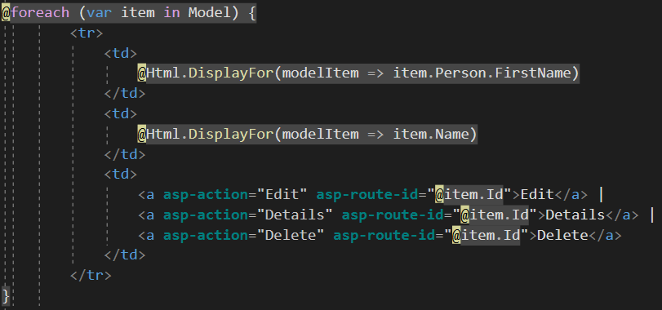
View
Views display information to the user
Files are .CSHTML
.CSHTML files contain both HTML and RAZOR code
RAZOR is converted to html server-side
Notes:
Razor being converted to HTML server-side means that it loads FIRST, then HTML/CSS/JavaScript (client-side).

Slide 8
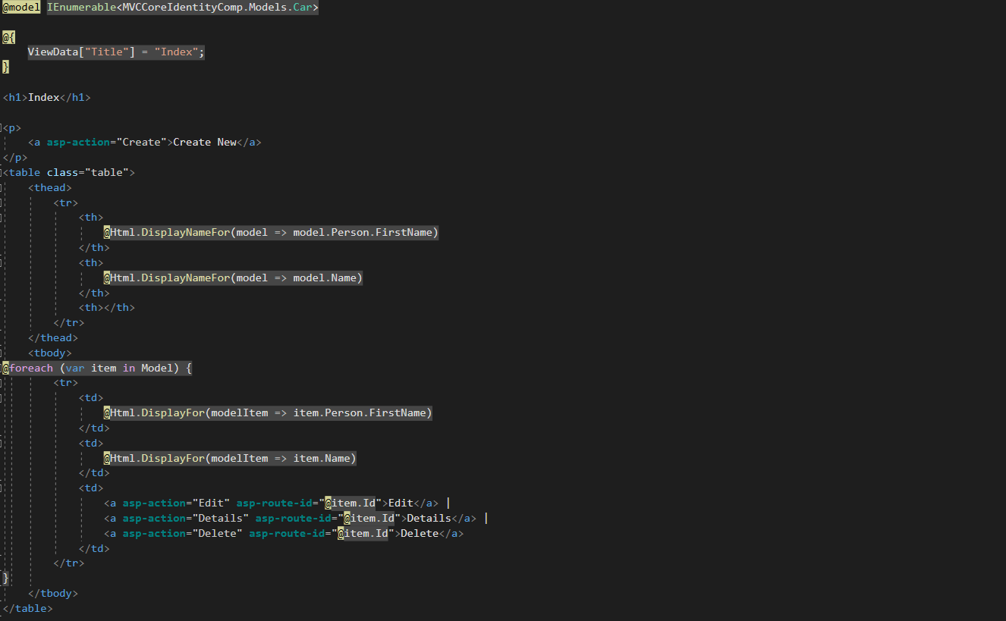
View (Index.cshtml example)
Notes:
No need to go overly in-depth.

Slide 9
RAZOR Code
RAZOR Code is denoted by the @ symbol
Using the @ symbol allows us to write C# logic in the view or use any of the predefined HTML helper functions

Slide 10
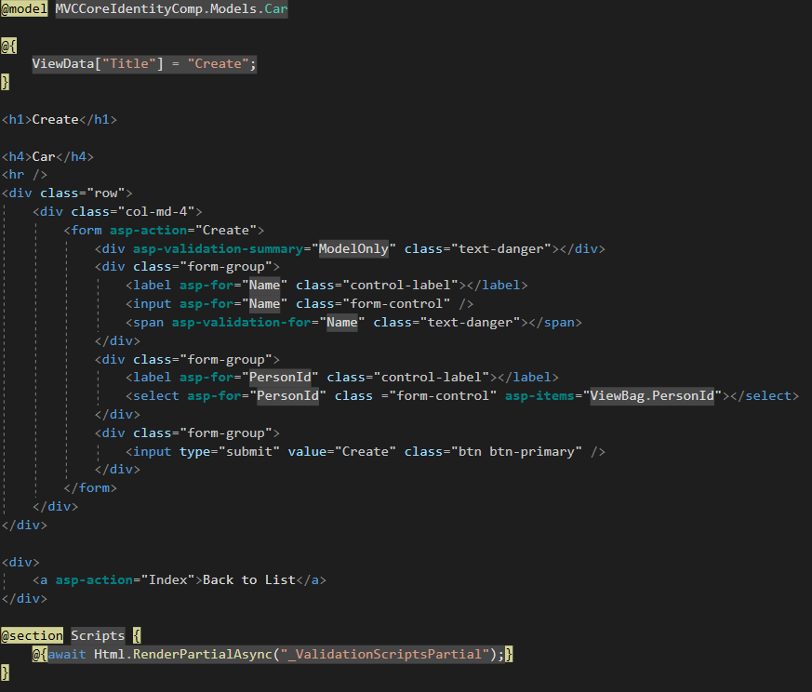
Razor Code (Create.cshtml example) CORE

